Slide 1
Projects In Express
Pug / Jade & Template Engines

Slide 2
What Is a Template Engine?
Enables you to use use static template files in your app
Variables are replaced at runtime
Most template engines allow variables, conditionals and loops
Popular engines include Pug/Jade, EJS, Handlebars and Mustache

Slide 3
Implementing a Template Engine
app.js
app.set(‘views’, path.join(__dirname, ‘views’));
app.set(‘view engine’, ‘pug’);
In Route
res.render(‘index’, {title: ‘Express’});

Slide 4
Pug/Jade
Formerly known as Jade but was renamed to Pug
Pug will still occupy the the “Jade” package name
Some small changes in syntax and API

Slide 5
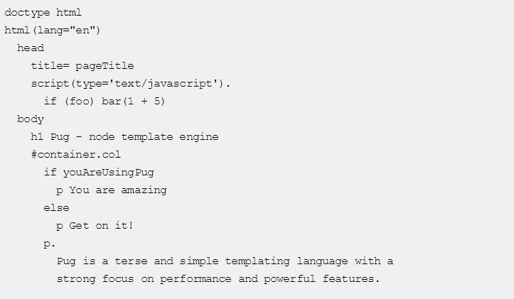
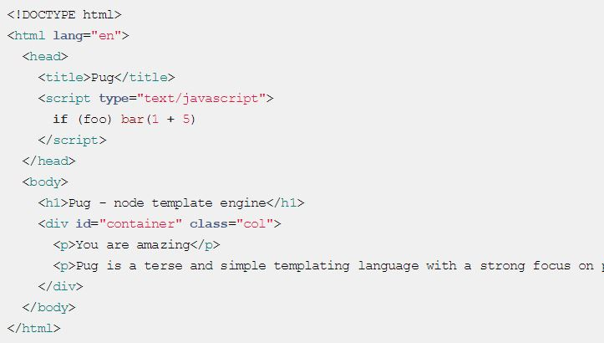
Pug Syntax

Slide 6


